Slide 1

Islamic University of Technology
Course no: Phy 4143
Course Title: Physics II
Course Teacher : Dr Md. Sahab Uddin
Professor

Slide 2
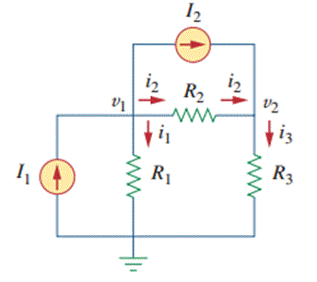
Nodal Analysis
Kirchhoff's Current law
Ohm’s law
Nodal Analysis Definition: Nodal analysis is a method for analyzing electric circuits by calculating voltages at different points, or nodes, in the circuit.
Kirchhoff’s Current Law (KCL): KCL is used in nodal analysis to ensure the total current entering a node equals the total current leaving, which is fundamental for setting up the equations.
Reference and Non-Reference Nodes: Reference nodes are used as a baseline or zero voltage point, while non-reference nodes are the points where voltage is measured and calculated.
Handling of Components: In nodal analysis, components like resistors and current sources are used to formulate equations based on Ohm’s Law.
Identify the nodes
Apply KCL at each node
Write Equations for each node using Ohm’s law
Solve the equation to find Node voltages

Slide 3


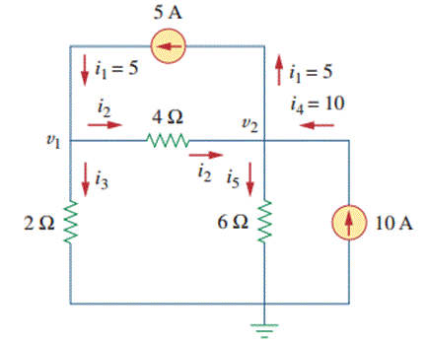


Nodal Analysis with Current Sources
Nodal analysis with current sources is very easy and it is discussed with an example below.
Step I. Assign the nodes voltages as v1 and 2 and also mark the directions of branch currents with respect to the reference nodes
Step II. Apply KCL to Nodes 1 and 2
KCL at Node 1
Example: Calculate Node Voltages in following circuit
Step III. Apply Ohm’s Law to KCL equations Node 1 & 2 and simplifying
Step IV. Solving (3) and (4) gives
V₁ = 13.33 Volts and V₂ = 20 Volts
In circuit we have 3 nodes from which one is reference node and other two are non reference nodes – Node 1 and Node 2.

Slide 4
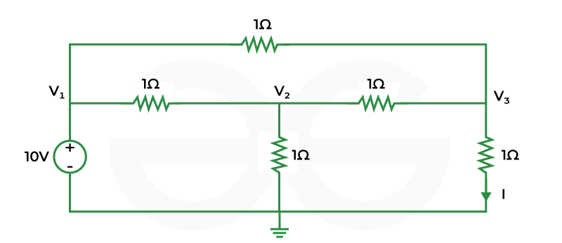
Q. Using nodal analysis find I(With Voltage source)
Ans. 5 A

Slide 5
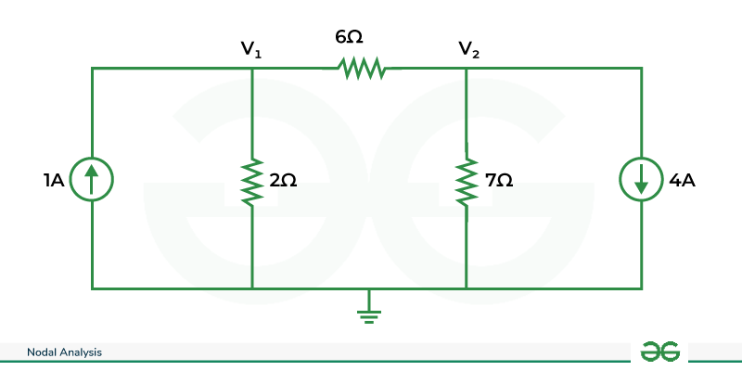
Question .Find V1 and V2 using nodal analysis (With current Source)
Ans. V1 = -2 V and V2 = -14 V

Slide 6
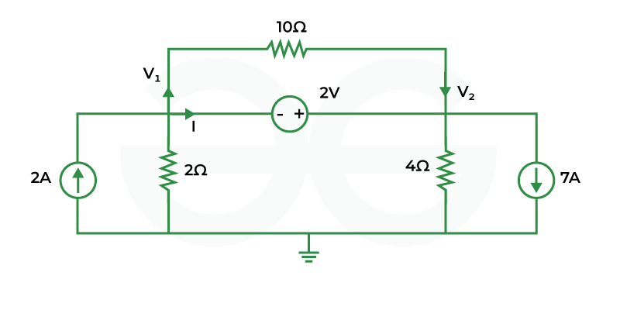
Super Node Analysis
Super node is special condition of nodes. When a voltage source is present between two non-reference node then it is called as super node. KVL and KCL are both applied to the super node to solve the equations.
Properties of Super node
It does not have well defined voltage
Both KCL and KVL are required to solve the equations
The voltage difference is zero between any two nodes in super node
Q. Using nodal analysis find V₁ and V₂
V1=-7.33 V
And V2= -5.33 V

Slide 7
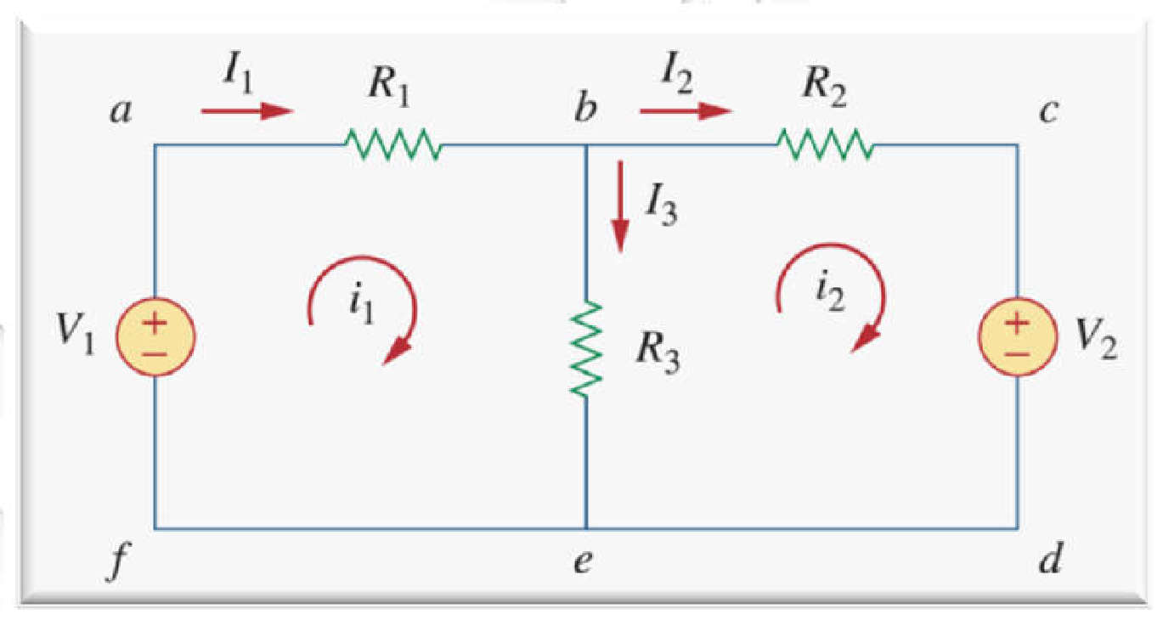
Mesh Analysis
Kirchhoff's Voltage law
Ohm’s law
Mesh analysis is also known as loop analysis or the mesh current method.
Nodal analysis applies KCL to find unknown voltages in a given circuit, while mesh analysis applies KVL to find unknown currents.
The current through a mesh is known as mesh current.
Steps
1. Make a clear diagram.
2. Assign mesh currents i1, i2, i3, …, in to the n meshes.
3. Apply KVL to each of the n meshes. Use Ohm’s law to
express the voltages in terms of the mesh currents.
4. Solve the resulting n simultaneous equations to get the
mesh currents.

Slide 8
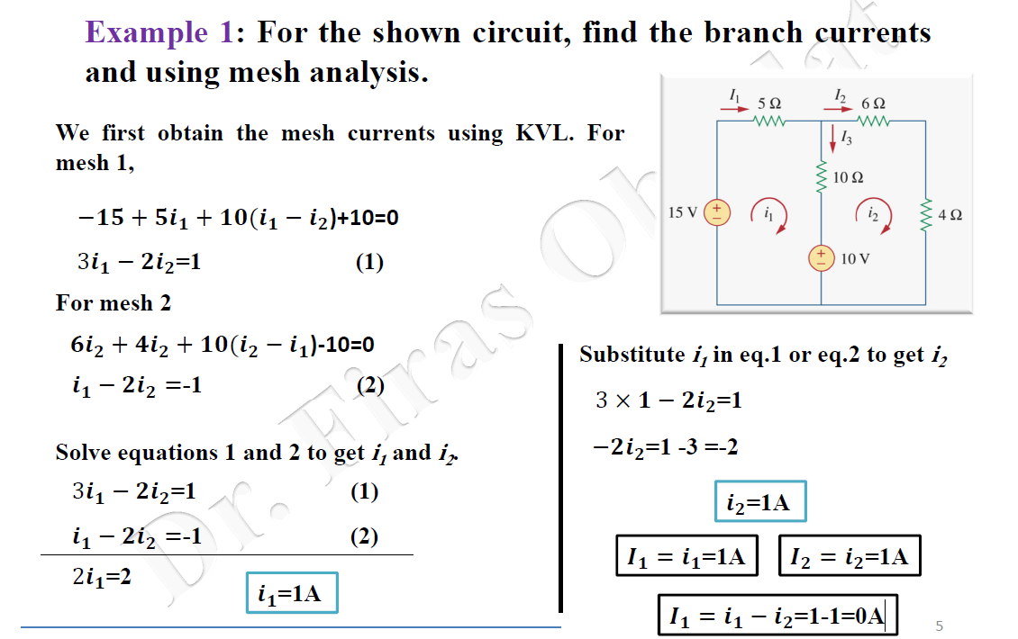

Slide 9
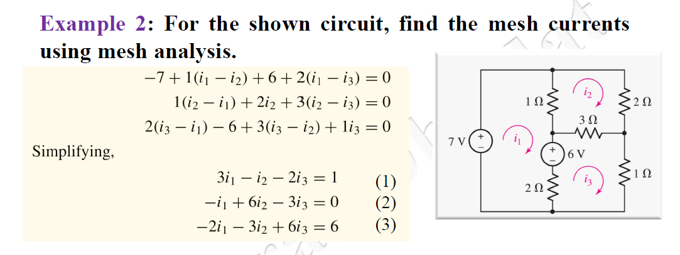

Slide 10
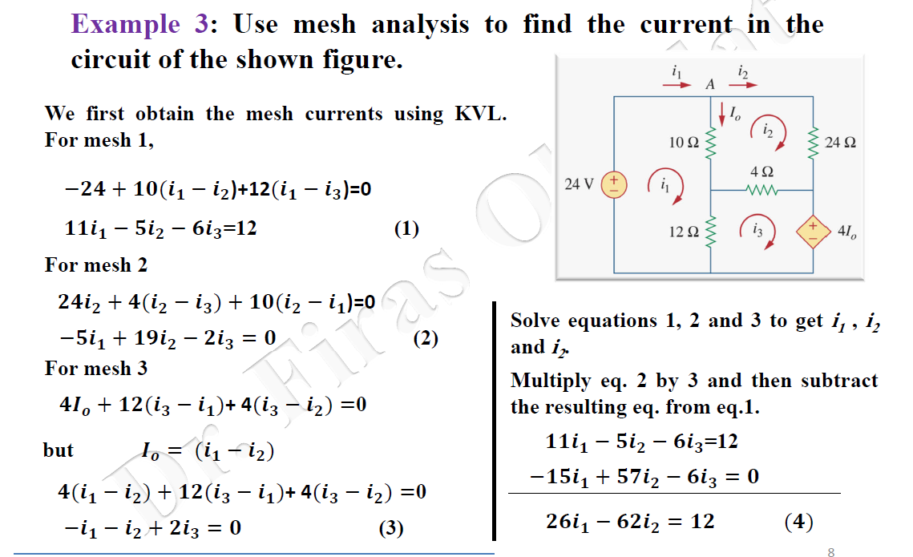

Slide 11
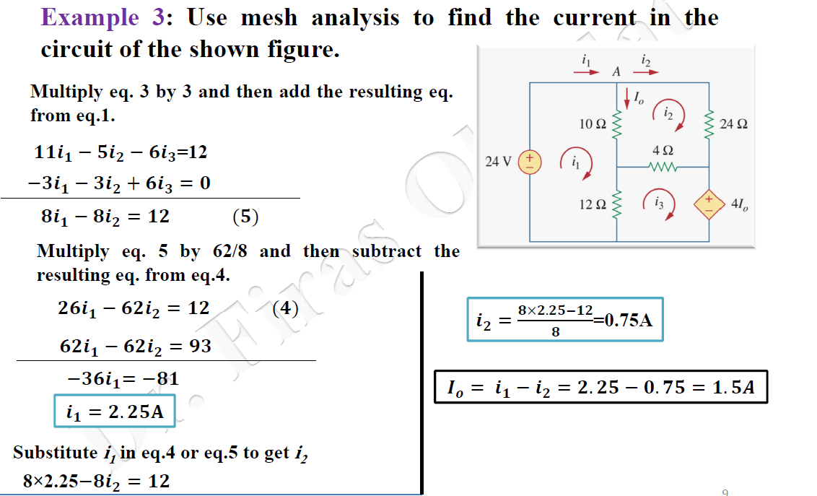

Slide 12
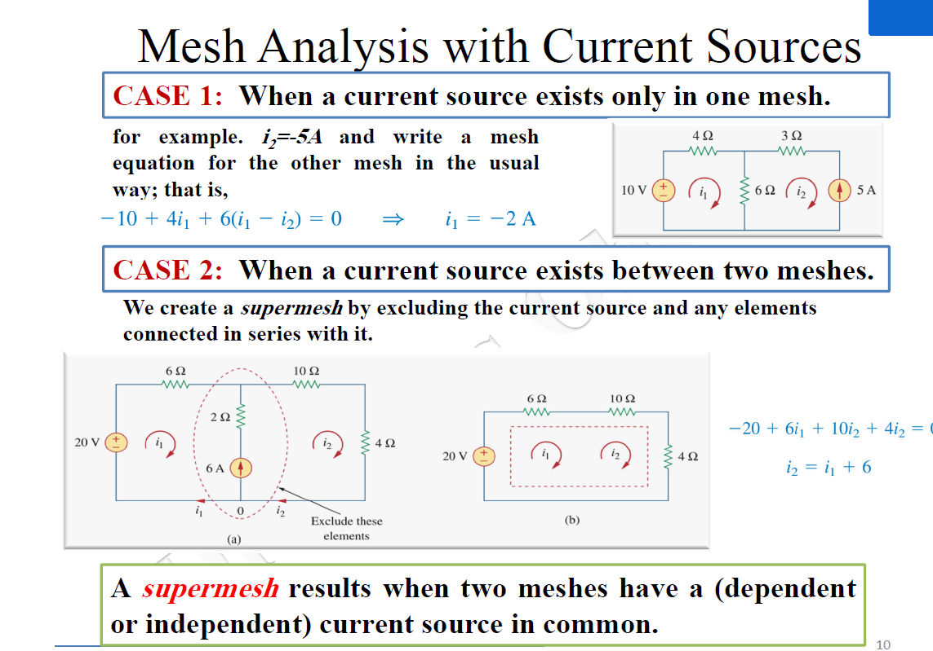

Slide 13
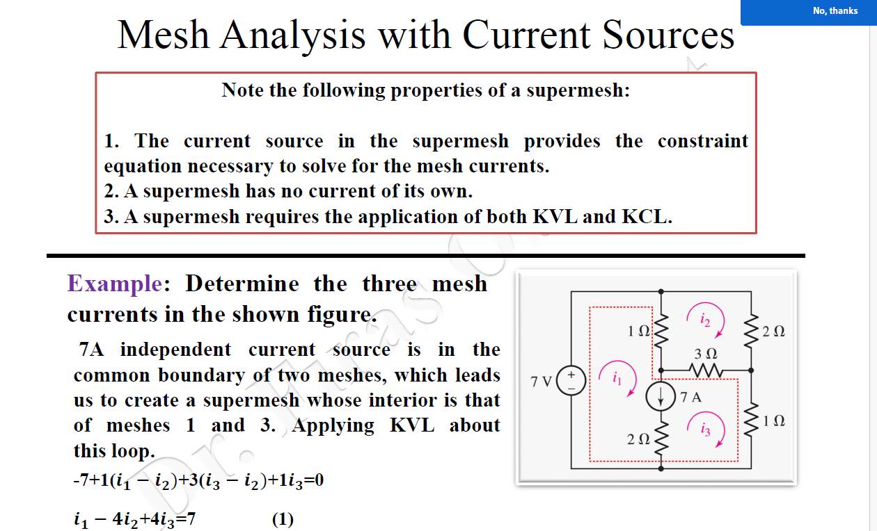

Slide 14
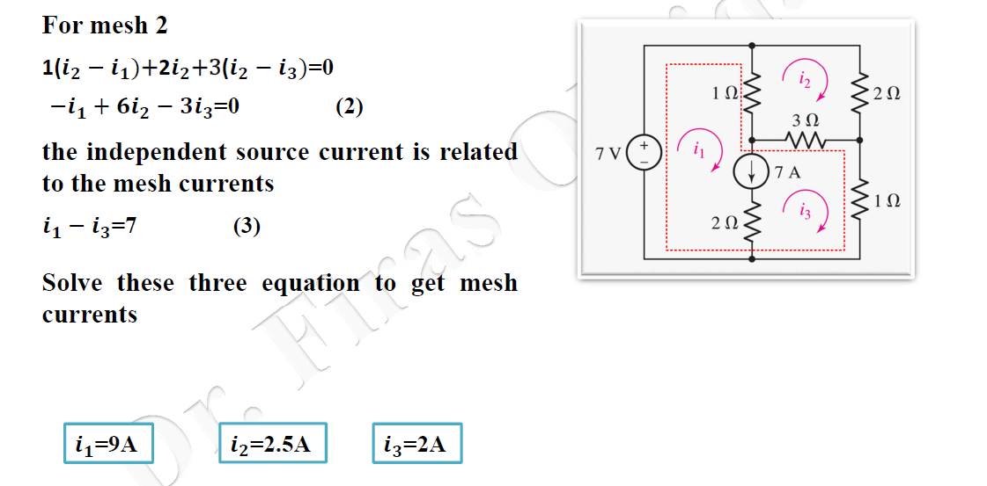

Slide 15
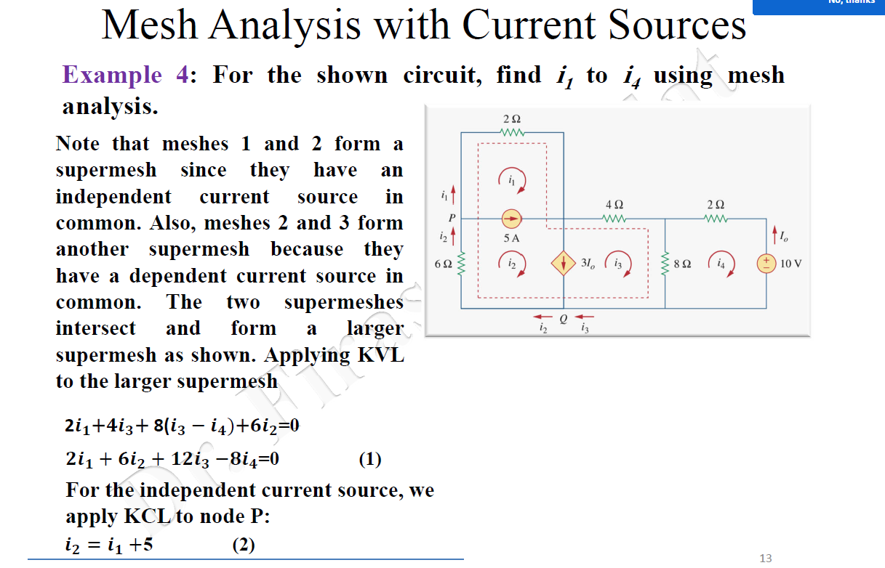

Slide 16
